Slide 1

2021
Danilo II Veroy

Slide 2
Version Control System (VCS)
2021
For tracking changes in computer files
Distributed version control
Works between multiple developers
Local & remote repos
Who made what changes and when
Revert back at any time
What is git?
Notes:
Distributed – what it means by that is many developers can work on a same version and can be saved in the remote repository as well as in local repositories of the local machines

Slide 3
CONCEPTS OF GIT
Keeps track of code history
Takes “snapshots” of your files
You decide when to take a snapshot by making a “commit”
You can visit any snapshot at any time
You can stage files before committing
2021

Slide 4
ESSENTIAL COMMANDS
2021
Commands
Description
git init
git add <file>
git status
git commit
git push
git pull
git clone
// Initialize local git repository
// Add file(s) to index
// Check status of working tree
// Commit changes in index
// Push to remote repository
// Pull latest from remote repository
// Clone repository into a new directory
Notes:
Init – initializing your git to the folder
Add – adding files in stage before commiting
Status – show all the status if there is for add, delete or for update or even the not yet added to index
Commit – commit the indexes
Push – pushing to remote repo
Pull – copying the latest copy on repo
Clone – duplicating the repo to your directory

Slide 5
INSTALLING GIT
2021
http://git-scm.com/download/win
Notes:
Git (git-scm.com)

Slide 6
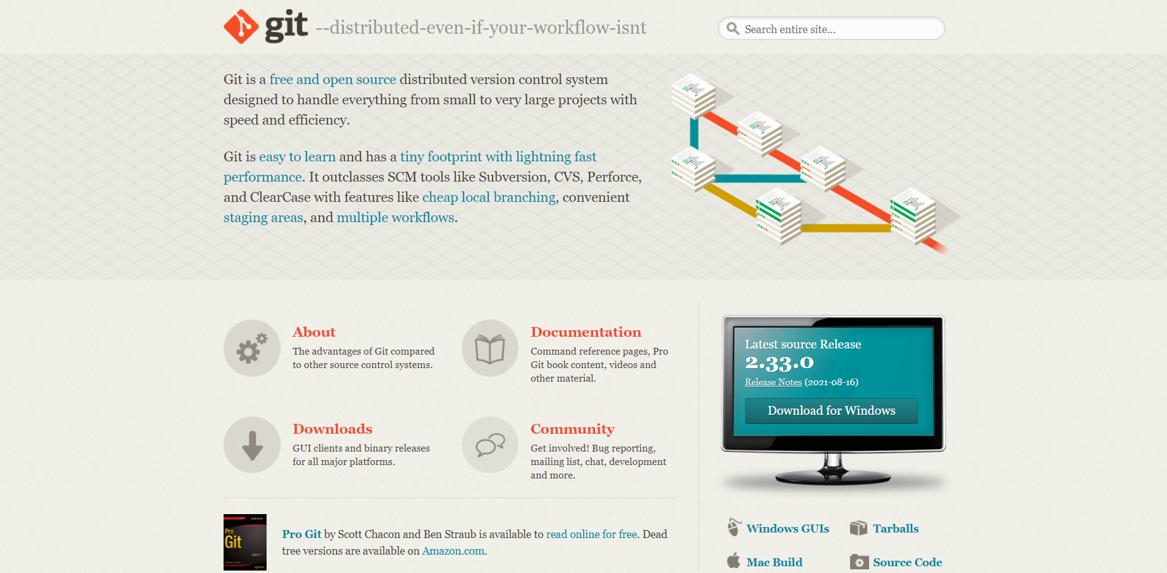
http://git-scm.com/
2021

Slide 7
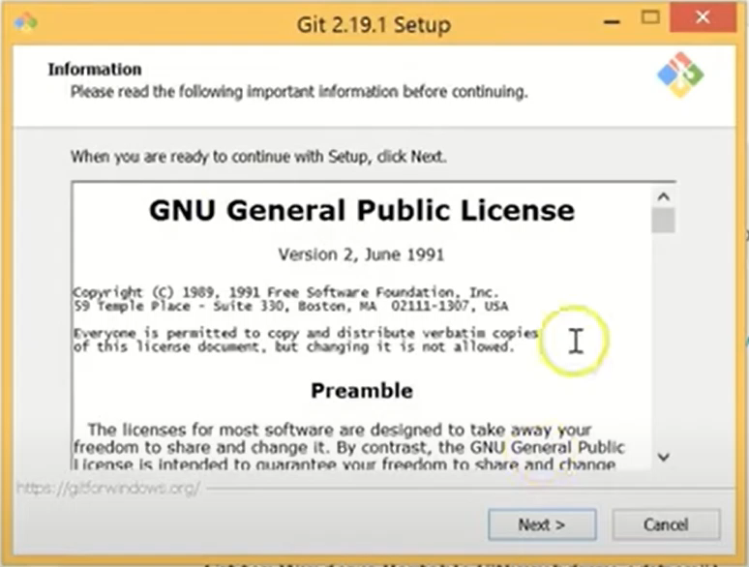
2021

Slide 8

DEMO
2021
Using git bash

Slide 9
GOALS OF SOURCE CONTROL
2021
Versioning of files
Improved development process
Historical view
Work with a team

Slide 10






SUMMARY
2021
What is git
Concepts of git
Essential Commands
Version control system
Keeps track of code history
Git commands
Installing Git
Demo
Goals of Source Control
http://git-scm.com/
Using git bash
Versioning of files

Slide 11
THANK YOU!
2021
“Talk is cheap. Show me the code.”
― Linus Torvalds

